Slide 1
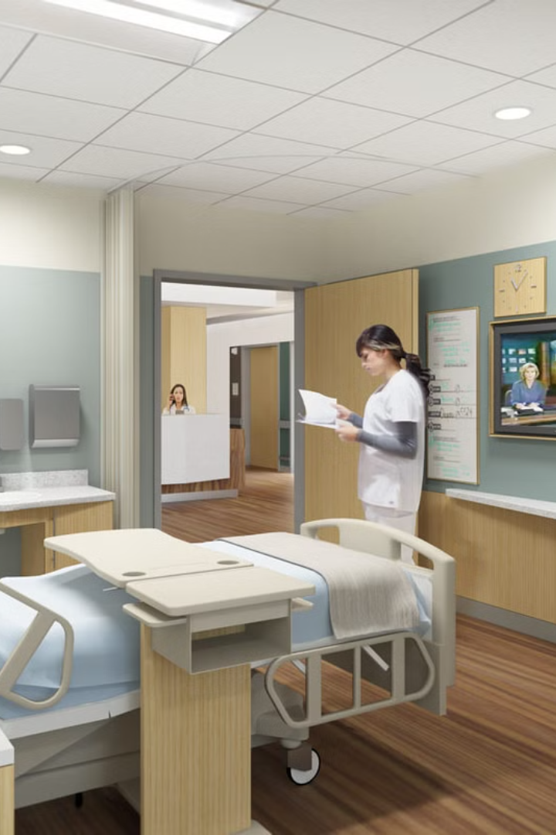

HealthX: Empowering Healthcare
Welcome! Today, we'll explore the development of a state-of-the-art Hospital Management System that leverages cutting-edge technologies to improve patient care, enhance efficiency, and empower healthcare professionals.

Slide 2
Introduction: A Vision for the Future
Streamlining Healthcare
Key Features
Our system aims to streamline healthcare services for patients, doctors, and administrators. It integrates key features to improve the patient experience, enhance efficiency, and ensure smooth operations.
Key features include patient registration, appointment booking, AI-driven chatbot, voice control, and telemedicine, all designed to improve healthcare accessibility and efficiency.

Slide 3




Motivation: Addressing Critical Needs
Bridging the Gap
The pandemic highlighted the need for digital healthcare solutions to ensure access to care for patients in remote areas.
Accessibility for All
Voice control enables patients with disabilities to interact with the system hands-free, promoting inclusivity.
Instant Medical Assistance
The AI-based chatbot offers instant medical assistance to users, answering questions and providing guidance.

Slide 4



Problem Statement & Objectives
Challenges in Traditional Systems
Existing hospital systems often lack AI-driven automation, telemedicine, and voice accessibility, leading to inefficiencies and manual processes.
Our Objectives
We aim to develop an HMS with AI chatbot, voice control, and telemedicine support, ensuring secure role-based access and data privacy.

Slide 5
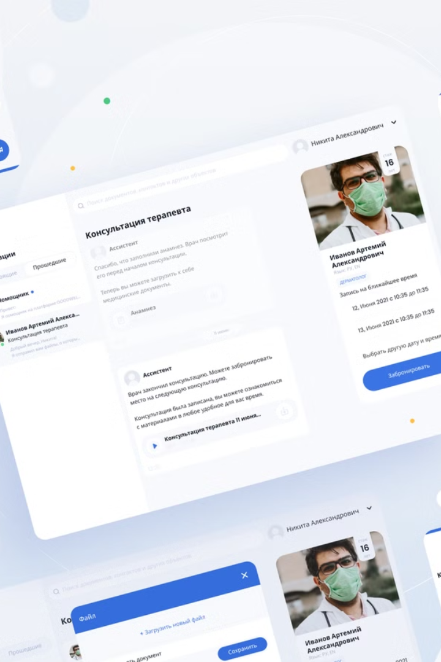
Key Features: Empowering Efficiency and Accessibility
Patient Registration & Appointment Booking
AI-Driven Chatbot
An intelligent chatbot uses AI/ML to suggest medications based on user-reported symptoms, providing quick medical advice.
Streamlined registration and appointment booking processes, offering convenience to patients.
Telemedicine
Voice Control
Real-time video consultations with doctors using WebRTC, extending healthcare access to remote areas.
Hands-free interaction with the system using voice commands, promoting accessibility for diverse users.

Slide 6
Tech Stack: Building the Foundation
Frontend
Backend
Database
HTML, CSS, JavaScript, React.js for a responsive and engaging user interface. Voice API for voice control.
Node.js, Express.js for robust API development. WebRTC for real-time telemedicine. Twilio API for SMS notifications.
MongoDB for efficient data storage. MySQL/PostgreSQL for relational data management. Firebase for real-time data synchronization.

Slide 7




System Architecture: A Seamless Integration
User
1
Patients, doctors, and administrators interact with the system through the user interface.
Server
2
The server handles requests, processes data, and interacts with the database and APIs.
Database
3
Stores and manages patient data, appointments, and medical records securely.
API Services
4
Connect with external services like the chatbot, telemedicine platform, and security services.

Slide 8
Proposed Methodology: A Structured Development Process
1
Requirement Analysis
Identify key modules, user roles, and system requirements to define the scope of the project.
2
System Design
Design the user interface (UI), develop flow diagrams, and finalize the architecture of the system.
3
Frontend Development
Build the user interface using React.js and integrate voice control functionalities.
4
Backend Development
Develop APIs for patient registration, appointment booking, and other key features.
5
AI Chatbot Integration
Integrate Dialogflow and NLP models for chatbot functionality, enabling medical advice based on symptoms.
6
Telemedicine Integration
Implement WebRTC for real-time video consultations, facilitating remote healthcare access.
7
Testing & QA
Conduct thorough testing of APIs, UI, and chatbot response accuracy to ensure quality and functionality.
8
Deployment
Deploy the system using CI/CD, Docker, and cloud platforms like AWS or Heroku.

Slide 9
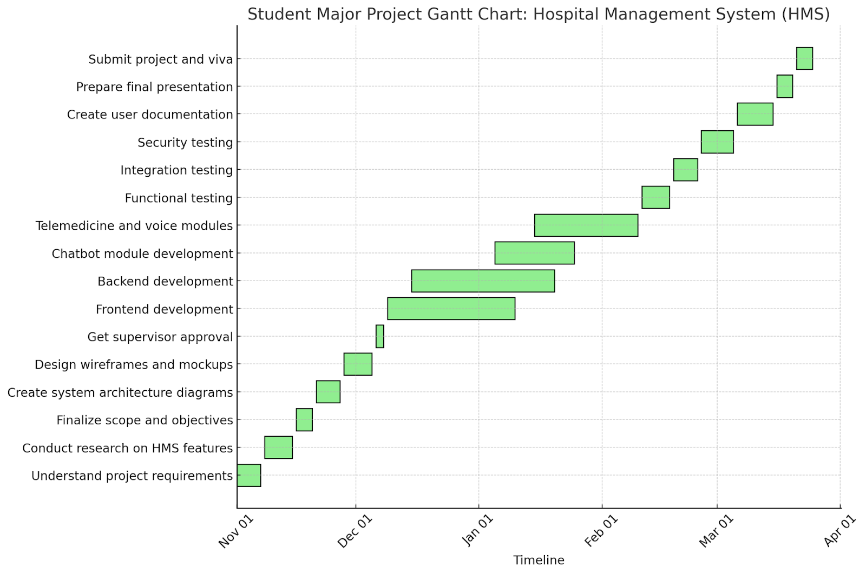
Gantt Chart: A Visual Plan of Work
8
Weeks
Our project timeline spans 8 weeks, covering all phases from requirement analysis to deployment.

Slide 10

Conclusion: A Future-Ready Healthcare Solution
AI-Powered Automation
Enhanced Accessibility
This Hospital Management System leverages AI-driven automation for tasks like appointment scheduling and medical advice.
Telemedicine and voice control make healthcare services more accessible to patients, regardless of location or ability.
Data Security
Data security measures such as encryption, authentication, and HIPAA compliance protect patient information.

Slide 11
FLOW CHART DIAGRAM

Slide 12
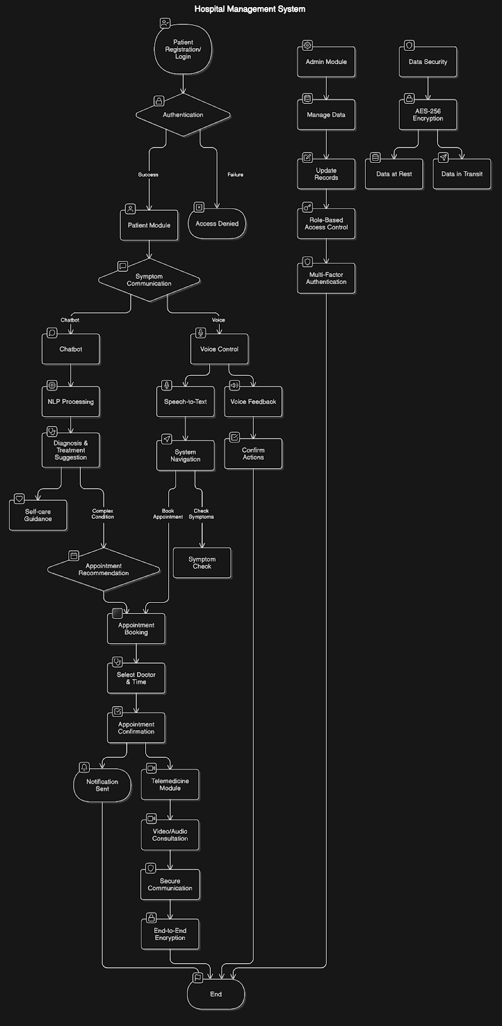

Slide 13
REFERENCES
Smith, J., & Brown, R. (2023). Developing an AI-powered Chatbot for Healthcare Systems. Journal of Artificial Intelligence, 45(3), 112-130.
Lee, K., & Kim, H. (2022). Telemedicine in Modern Healthcare: Challenges and Benefits. International Health Journal, 29(4), 213-230.
Patel, S., & Gupta, R. (2021). Data Security in Healthcare: HIPAA Compliance and Best Practices. Cybersecurity Today, 19(2), 45-60.
Kumar, A., & Singh, M. (2022). Voice-Enabled Technologies for Accessibility in Healthcare Systems. Journal of Accessibility, 12(7), 98-110.
Sharma, P., & Verma, N. (2023). Machine Learning Models for Symptom-Based Diagnosis. International Journal of Machine Learning and AI, 41(1), 18-40.

Slide 14
Made By:
Akshat Srivastava 2100520100112
Pankaj Mohan Awasthi 2100520100142
Abhijeet Rao 2100520100101
Under the guidance of:
Ms. Deepali Awasthi
Dr. Pawan Kumar Tiwari

Slide 15
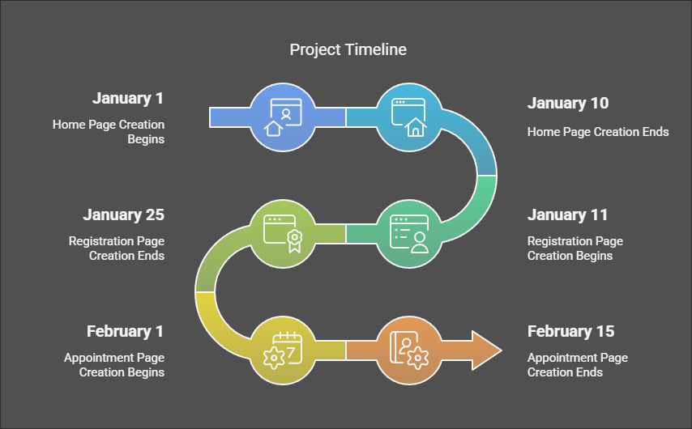

Slide 16
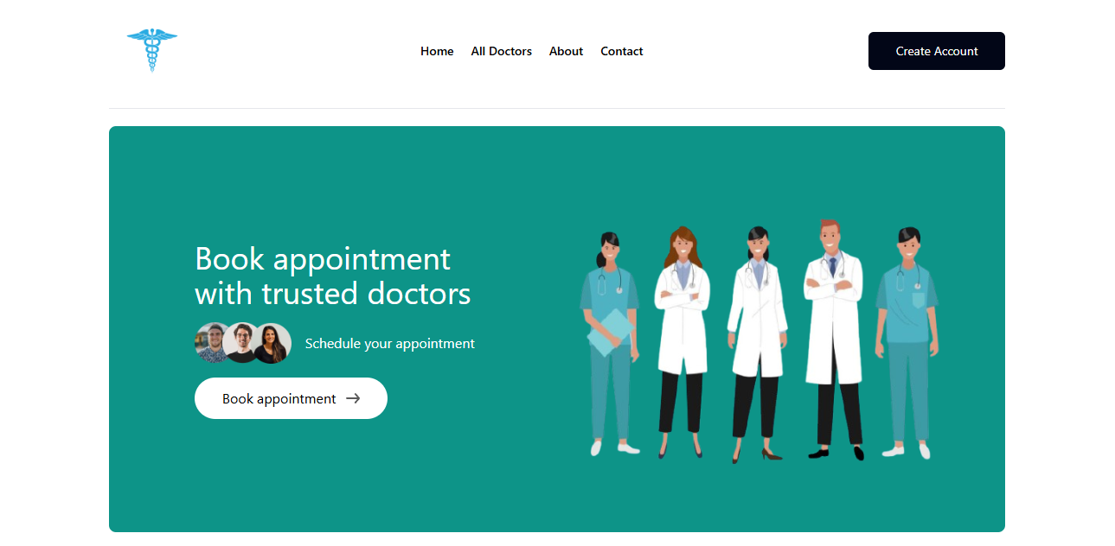
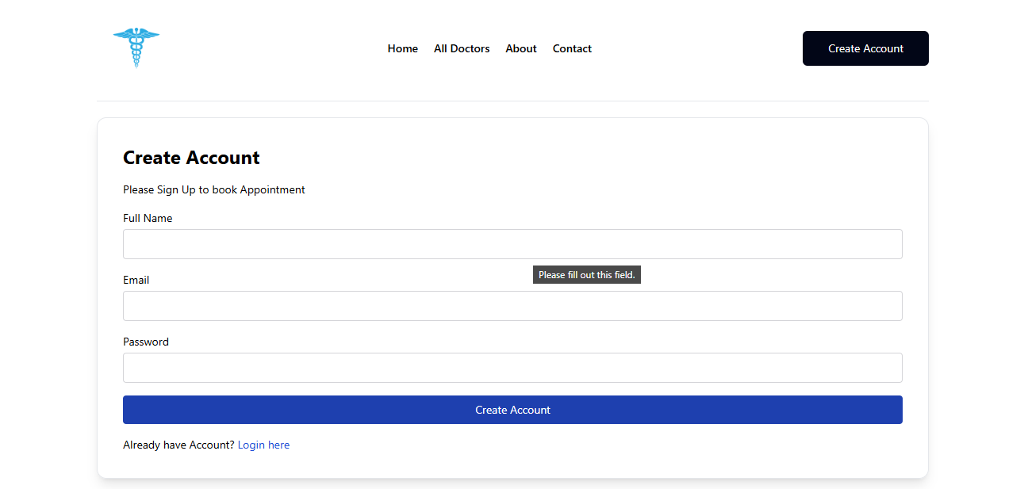
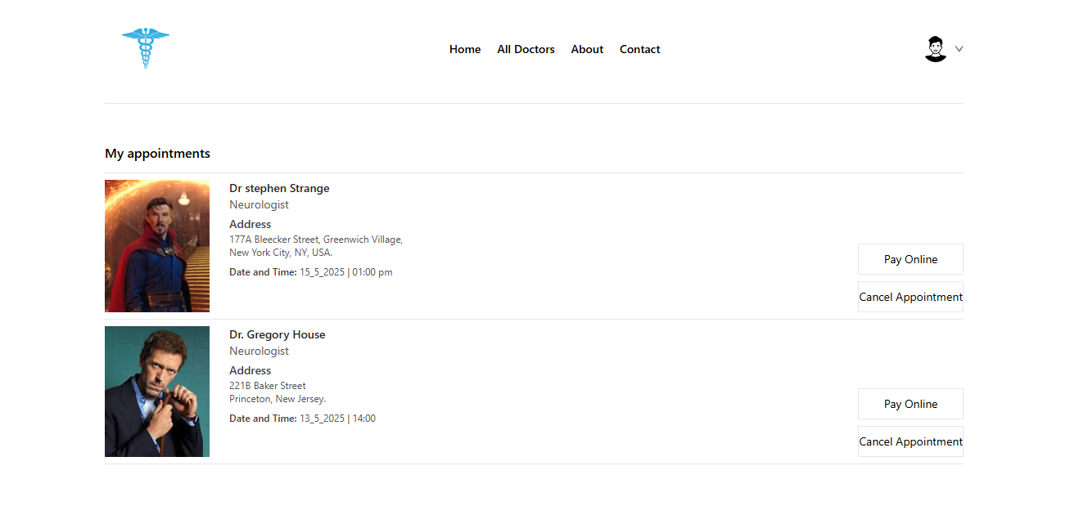
HomePage
Registration
Appointment

Slide 17
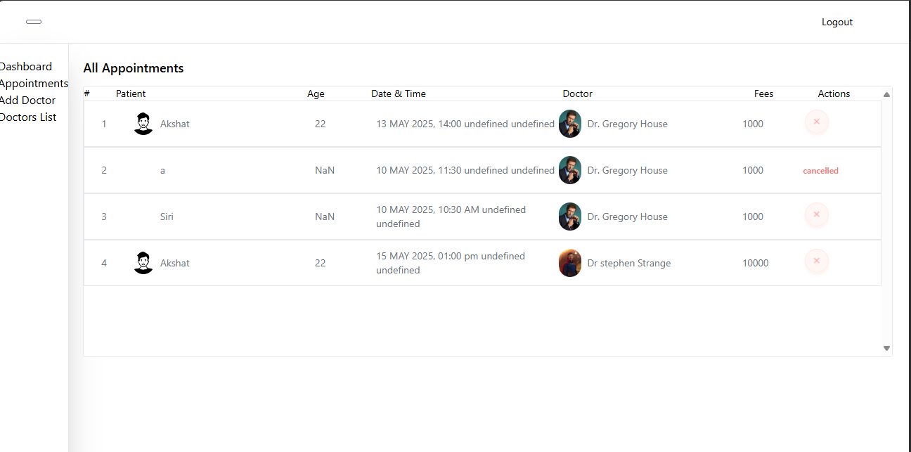
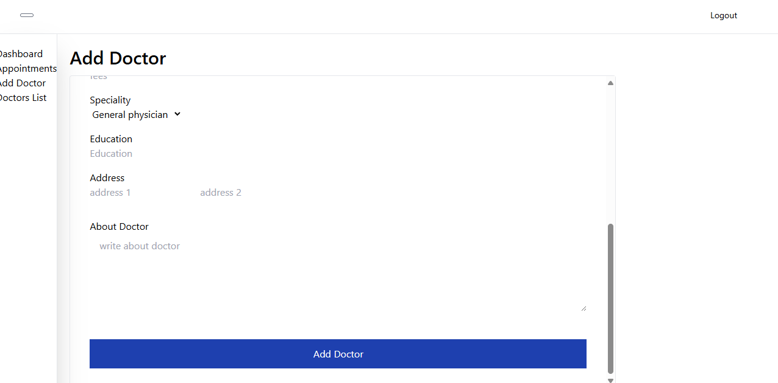
Admin

Slide 18
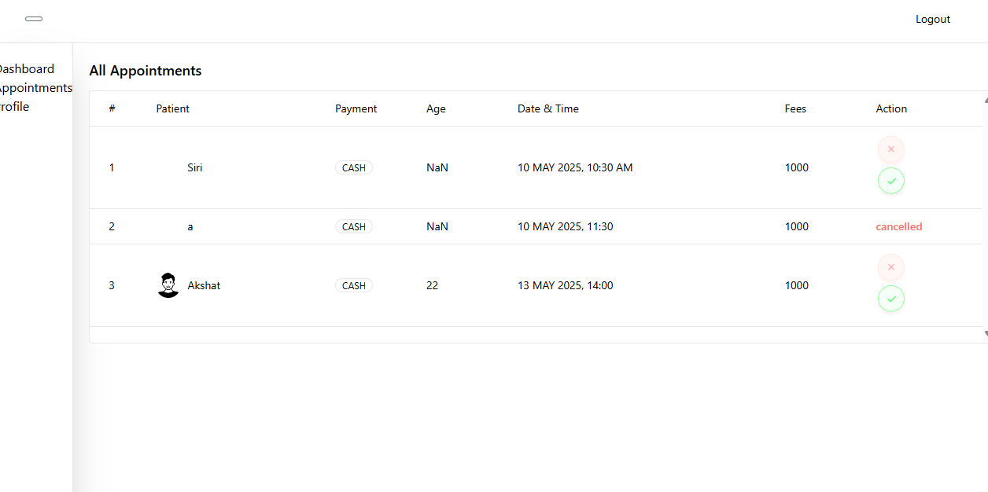
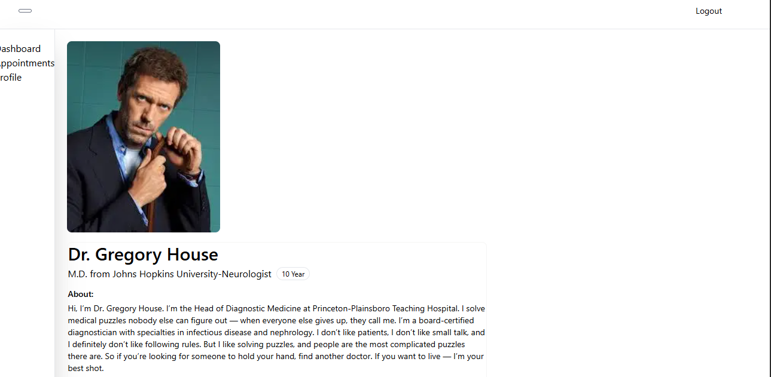
Doctor

Slide 19
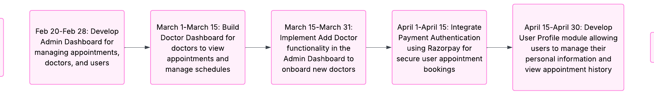
TIMELINE

